Slide 1
Massachusetts Climate Careers: Powering the Future
The Power of Climate Solutions
Notes:
Introduce the Massachusetts Clean Energy and Climate Plan for 2050, emphasizing the goal to reach net-zero emissions by 2050.
Massachusetts is pioneering solutions that affect daily life and address long-term climate goals.
Massachusetts is a national leader in climate technology and clean energy jobs and training.

Slide 2
Opening Activity
Personal Impact Inventory
Write down three actions you do every day that use energy.
What is one way you could reduce your energy use for each action?
Lesson 2. The Power of Climate Solutions
Notes:
Activity objective: Encourage students to start thinking about how their own actions can contribute to decarbonization and lower energy usage. This activity will set up students’ connection to broader climate solutions.
Instructions:
Ask all students to take one minute to write down three actions they take every day that use energy. Encourage students to think broadly. Examples could include turning on the lights in their homes, using heat/air conditioning, or transportation to and from school.
Ask students to write one or two ideas for each action that would help lower their energy usage.
Invite a handful of students to share some of their ideas aloud. Then, discuss as a group, highlighting that these daily actions, though small, have a significant environmental impact.
Variation—students can also do this exercise as a pair share rather than a group discussion.

Slide 3
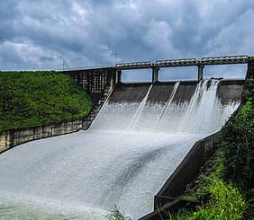
The Big Question and My Climate Goals
Climate Watch and Discussion
Climate Change
Today’s Group Activity
Key Takeaways and Closing
Lesson 2. The Power of Climate Solutions

Slide 4
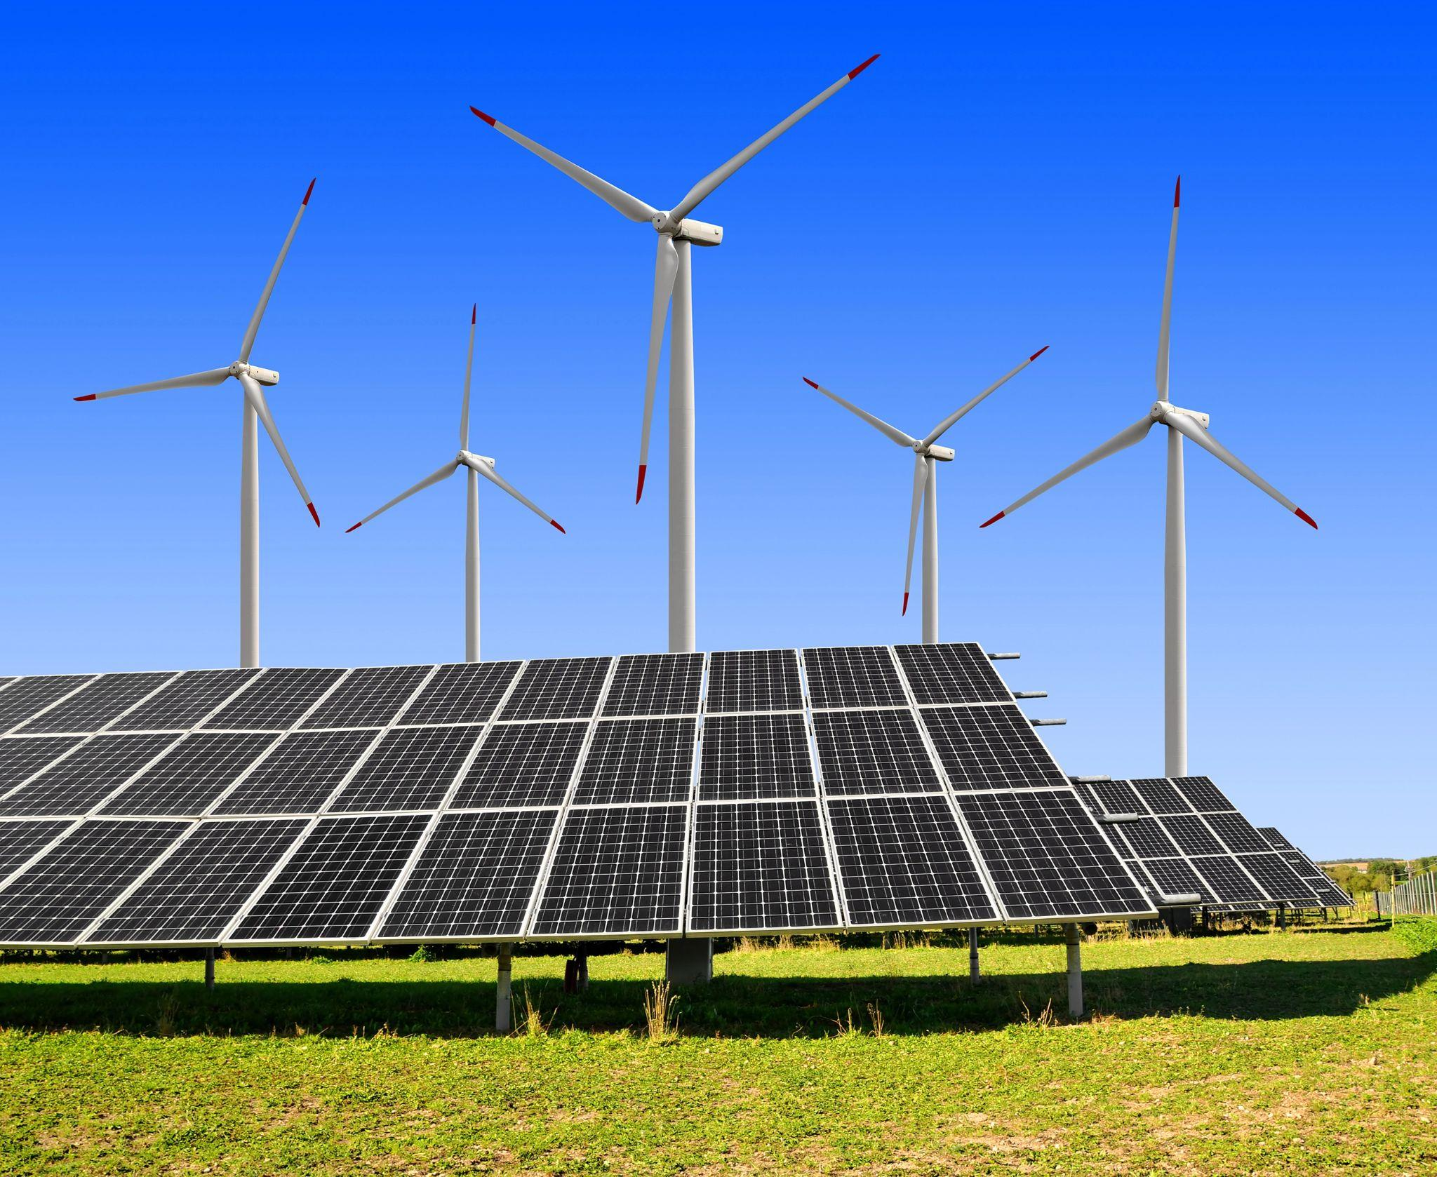
The Big Question
How is Massachusetts working to be more efficient, transition to renewable energy, optimize energy transmission, protect natural lands, and prepare for climate challenges?
Lesson 2. The Power of Climate Solutions
Notes:
How is Massachusetts working to make our energy use more efficient, support renewable energy, and protect natural lands?
Ask students to reflect on the question.
By the end of the lesson, they will have tools to begin to answer it and to relate this question and its answer to their own lives.

Slide 5
When you complete this lesson, you’ll be able to
Identify strategies to improve energy efficiency
Identify examples of climate technology that advances the use of renewable energy sources
Explore how different combinations of climate solutions can position us for a healthier future.
My Climate Goals
Lesson 2. The Power of Climate Solutions
Notes:
These objectives are the goals for today’s explorations.
Strategies and technologies do not need to be large scale to be effective or worthwhile; daily individual habits can also be impactful and can add up to considerable change.

Slide 6
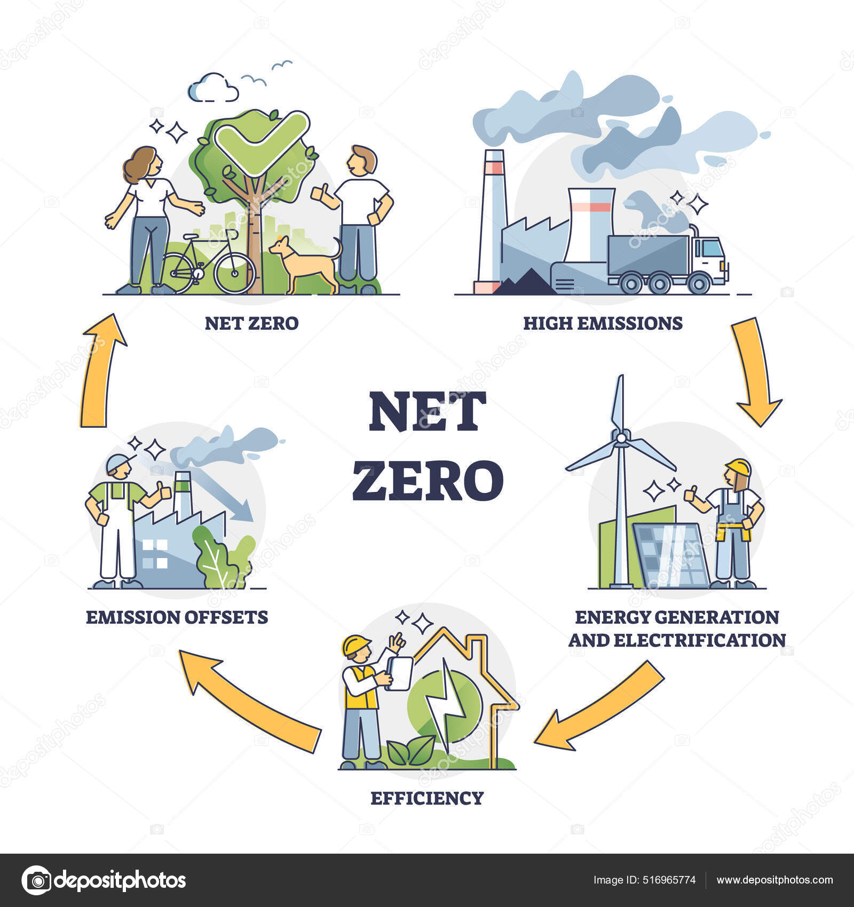
Massachusetts’s Vision for 2050
Sarah: If we don’t have time/the ability to create something that uses our actual 85% reduction target, we can see if this diagram from Deposit would work.
Net-Zero Emissions
Reduce carbon emissions by 85%.
Remove carbon from the atmosphere through sequestration.
Lesson 2. The Power of Climate Solutions
Notes:
Massachusetts’s climate plan drives toward the ultimate goal of achieving net-zero emissions by 2050.
”Net zero” means balancing the emissions we put into the atmosphere with those removed.
It’s likely impossible to emit absolutely zero carbon by 2050, so we need to combine efforts to lower carbon—reducing emissions—with efforts to capture or sequester existing carbon from the atmosphere.
We’re mostly going to focus on this first piece—reducing emissions. We can replace fossil fuels with clean energy sources, electric transportation, and improved efficiency.

Slide 7
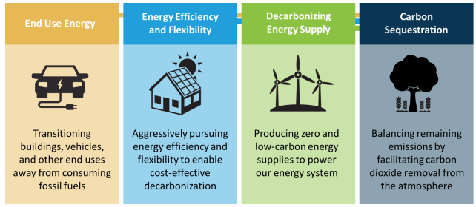
Decarbonization: What and How?
Image: Massachusetts Clean Energy and Climate Plan for 2025 and 2030
Lesson 2. The Power of Climate Solutions
Notes:
Another term for this process is decarbonization. This means lowering the amount of carbon dioxide released into the atmosphere or actively removing carbon dioxide from the atmosphere.
Remember, carbon dioxide traps heat in Earth’s atmosphere and is a primary factor in climate change.
We must reduce the amount of carbon dioxide in Earth’s atmosphere to prevent it from getting too hot or climate change from getting worse.
[Source: MA 2050 Decarbonization Roadmap]

Slide 8
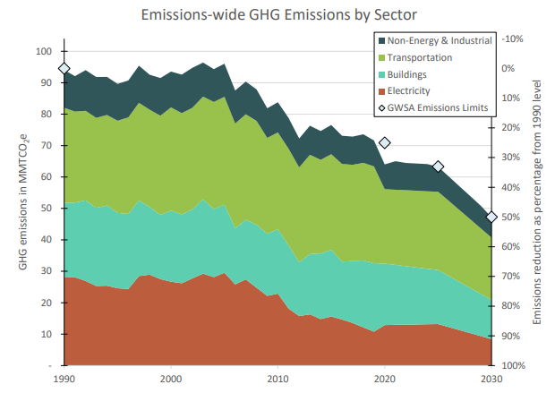
Projected Greenhouse Gas Emissions
Massachusetts envisions a future with minimal reliance on fossil fuels for heating homes, powering vehicles, and operating the electric grid.
Image: Massachusetts Clean Energy and Climate Plan for 2025 and 2030
Courtesy XXXXXX
Lesson 2. The Power of Climate Solutions
Notes:
This figure, from Massachusetts’s Clean Energy and Climate Plan for 2025 and 2030, shows the historical greenhouse gas (GHG) emissions in Massachusetts by four major economic sectors:
electricity,
buildings,
transportation, and
non-energy and industrial sectors.
The diamonds represent goals for GHG reduction in 2020, 2025, and 2030.

Slide 9
Climate Watch Video
Courtesy Unesco
Lesson 2. The Power of Climate Solutions
Notes:
Note to teacher: This video is a placeholder; the video created for this course will be available in spring 2025. You may skip this slide and the next if you wish.
Why and How Should Youth be Engaged with Climate Change?
Three-minute video from Unesco

Slide 10
Can you relate to what these young people are talking about?
Were there any ideas discussed in the video you’d like to learn more about?
Would you be interested in attending an event like this in the future?
Climate Watch Discussion
Lesson 1. Understanding and Combating Climate Change

Slide 11
Decarbonize the Electrical Grid
Lower energy usage through:
Energy-efficient buildings and transportation
Climate-conscious policies
Advanced technology
Meet rising demand through:
Electric public transportation
Renewable energy sources
Clean energy job training
Lesson 2. The Power of Climate Solutions
Notes:
Achieving Massachusetts’s climate goals will require multiple strategies to decarbonize the electricity sector while responding to the growing demands for resources such as heating and transportation.
Investments in solar energy and offshore wind, combined with imports of Canadian hydropower, all contribute to a decarbonized electricity grid.
Image: https://www.masscec.com/grid-modernization-and-infrastructure-planning

Slide 12
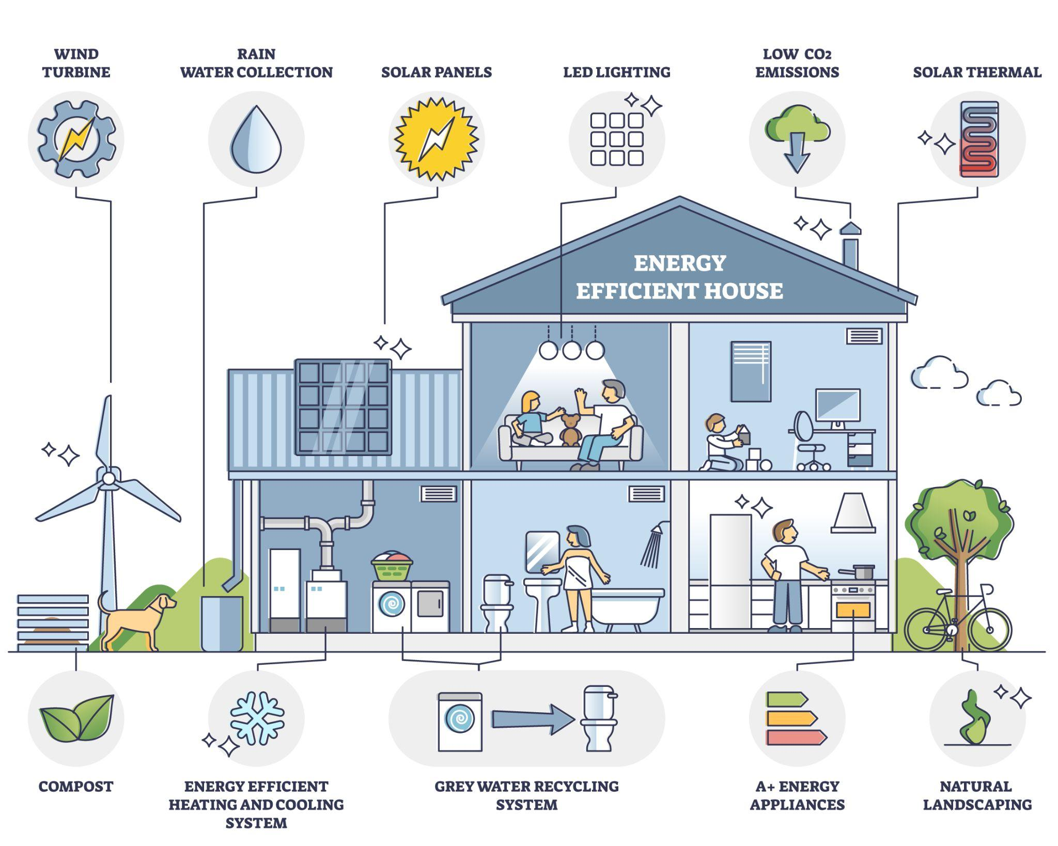
Strategy 1: Improve Energy Efficiency
Improve the energy efficiency of buildings:
Efficient design
Insulation and air sealing
Electric heat pumps
Lights and appliances
Smart technology
Lesson 1. Understanding and Combating Climate Change

Slide 13
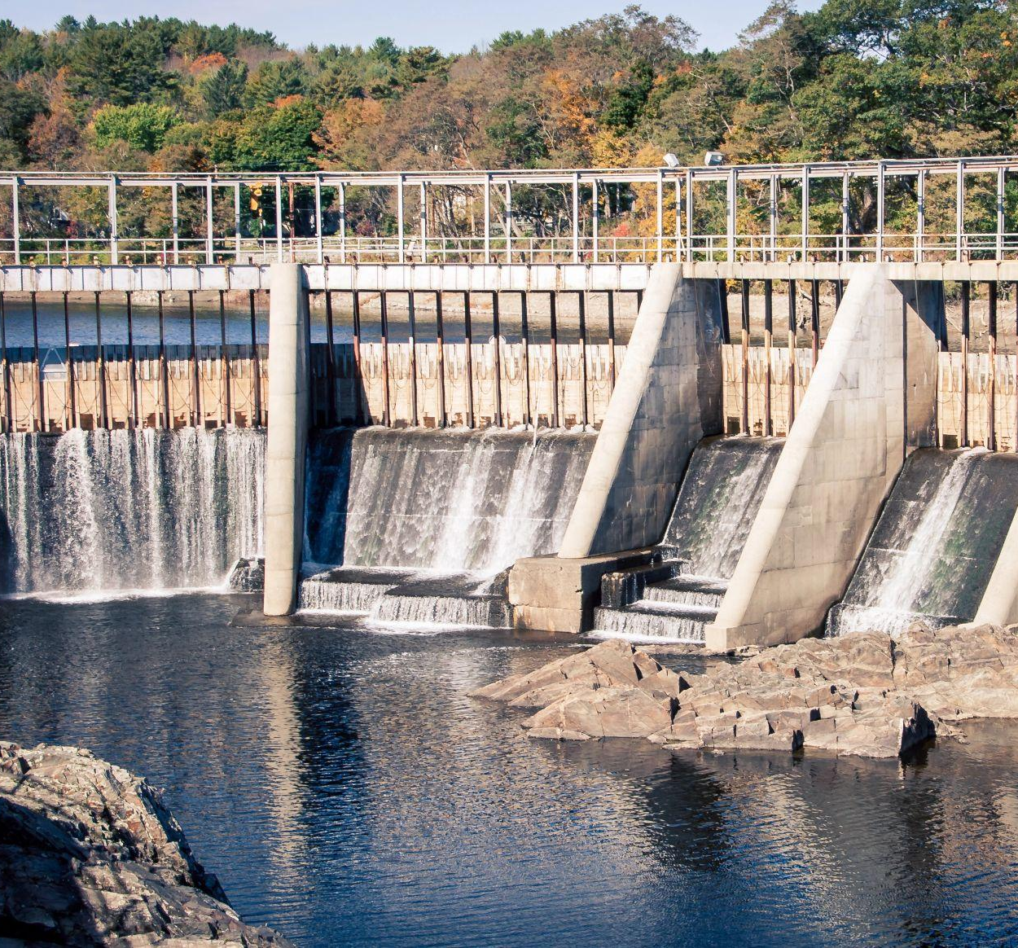
Strategy 2: Renewable Energy
Lesson 1. Understanding and Combating Climate Change

Slide 14
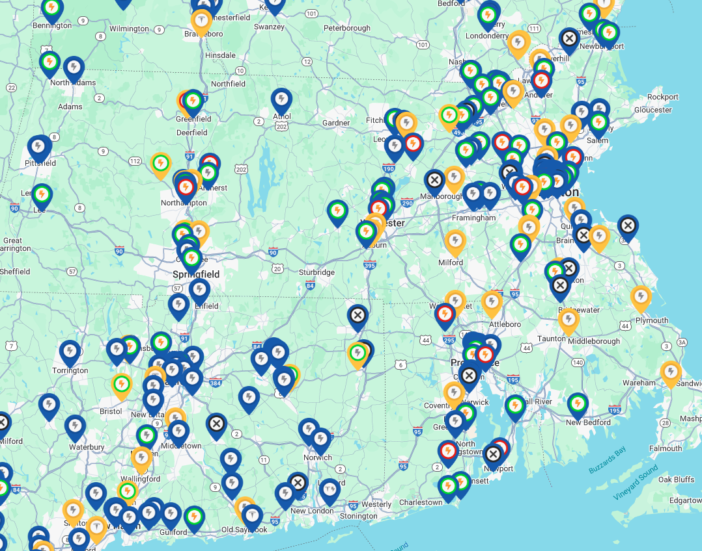
Strategy 3: Clean Transportation
This map shows all public electric vehicle charging stations across Massachusetts.
Lesson 1. Understanding and Combating Climate Change

Slide 15
Strategy 4: Conserve and Restore Natural Land
Conservation
Restoration
Urban greening
Lesson 1. Understanding and Combating Climate Change

Slide 16
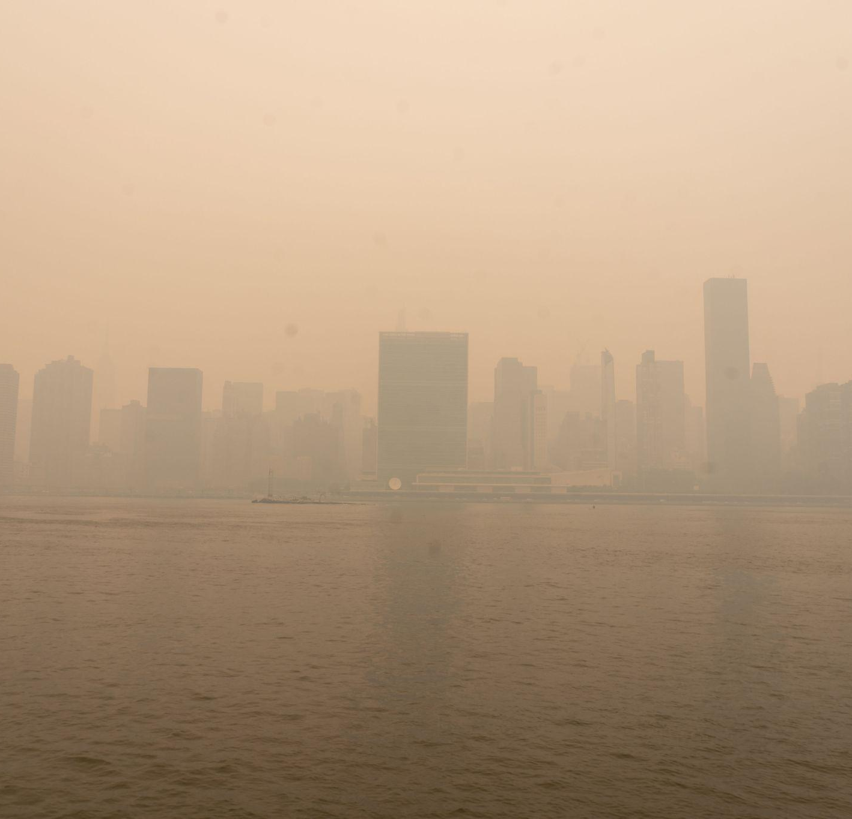
Community Impact
Lesson 2. The Power of Climate Solutions
Notes:
Ask students what their reaction is when looking at these two images.
The image to the right is New York City in 2023 with smoke from the Canadian wildfires.
Cleaner air and reduced pollution create healthier communities, particularly in densely populated urban areas.
The differences are not only on the surface, however.
This community on the left is more climate resilient. Its buildings are designed to be more efficient and to withstand certain climate events. Its grid and power sources are more efficient. Its public transportation is not only cleaner, its routes are also efficient, and it's likely been updated far more recently than the community on the left.
This doesn’t happen overnight. This doesn’t happen in only a decade. This might be a work in progress for 50 years. But every step of progress is significant.

Slide 17
Today’s Group Activity
Design Our Community’s Clean Energy Future
Lesson 2. The Power of Climate Solutions
Notes:
Activity objective: Invite students to apply what they have learned about Massachusetts’s strategies to decarbonize the state’s grid to their own community by determining their top two ways to improve energy efficiency and/or renewable energy in their community.
Students will work in small groups to create a plan to make their town greener using the strategies discussed in class today. Make sure students have their worksheets, which will help guide them through the activity.
Instructions:
Divide students into small groups of three or four students.
Each group will:
List and describe ways people in town use energy, for example, cars, home heating, or electricity. Encourage students to think about which energy use is most prominent in their town or in the areas/spaces they inhabit.
Think of areas that could be improved, and choose two improvements their group believes would make the biggest difference for the community, for example, adding public transportation or installing solar panels on rooftops of all public buildings.
Students may use ideas from any two of the strategies discussed today; should try not to use two solutions that fall into the same strategy category. For example, they shouldn’t suggest public transportation and electric personal vehicles as their two solutions.
Each group will share the energy issues they identified and the solutions they chose.
During presentations, prompt students to include why they chose the solutions they did and how they believe each solution will benefit the community (if they do not share this on their own)

Slide 18
Group Activity
In your groups:
Identify current energy use in your community.
Choose one or two solutions to make your town greener.
Share your community clean energy plan.
Lesson 2. The Power of Climate Solutions
Notes:
Instructions (same as previous slide):
Divide students into small groups of three or four students.
Each group will:
List and describe ways people in town use energy, for example, cars, home heating, or electricity. Encourage students to think about which energy use is most prominent in their town or in the areas/spaces they inhabit.
Think of areas that could be improved, and choose two improvements their group believes would make the biggest difference for the community, for example, adding public transportation or installing solar panels on rooftops of all public buildings.
Students may use ideas from any two of the strategies discussed today; they should try not to use two solutions that fall into the same strategy category. For example, they shouldn’t suggest public transportation and electric personal vehicles as their two solutions.
Each group will share the energy issues they identified and the solutions they chose.
During presentations, prompt students to include why they chose the solutions they did and how they believe each solution will benefit the community (if they do not share this on their own)

Slide 19
Activity Debrief
How do your plans connect to the Massachusetts Clean Energy Plan?
Which ideas work well with what Massachusetts is already doing?
How could your community’s choices affect Massachusetts’s goals for 2050?
Lesson 2. The Power of Climate Solutions
Notes:
Debrief discussion:
How do your plans connect to the Massachusetts Clean Energy Plan?
Which ideas work well with what Massachusetts is already doing?
How could your community’s choices affect Massachusetts’s goals for 2050?

Slide 20
Energy efficiency, renewables, and clean transportation are critical to a clean future.
We can contribute to the transition, both now and in our careers.
Massachusetts is leading by example, and we can support that in our community.
Lesson 2. The Power of Climate Solutions
Notes:
Summarize the key points students should take away from the lesson.
Each student makes choices that matter every day.
Clean energy careers will be essential in this journey to a clean energy future.

Slide 21
Closing Activity
Write a short postcard to your present-day self describing what life is like in Massachusetts in 2050’s cleaner, greener future.
What changes do you notice in your everyday life?
What’s different about the energy sources, transportation, or buildings?
How does the environment affect your community and family?
Lesson 2. The Power of Climate Solutions
Notes:
Activity objective: Encourage students to visualize the practical and everyday impact of the clean energy plan for daily life.
Invite students to write a short postcard to themselves from their future selves on large index cards.
Students hand in their index cards before exiting class.

